Slide 1


Design & Development of an Autonomous Automotive Parking System
Advancing Automotive Technology to Provide Convenient Parking Solution
Pyramids Higher Institute for Engineering and Technology
Mechatronics Department
7/2024

Slide 2
Our Team
Abdelrahman Abdulmoaez Ahmed
Abdelrahman Emad Ahmed
Daniel George Alfonse
Kareem Abdelkader Mohamed
Omar Ehab Elsayed
Peter Sameh Henri
Shehab Gomaa Mohamed
Youssef Yacoub Saad
Ayman Hamdy
Under the supervision of
Dr. Ahmed Abdelaziz Mohamed

Slide 3
Content
1- Introduction
2- Mechanical Design
3- Mechatronics System
4- Path Planning
5- Software
6- Conclusion and Recommendation

Slide 4
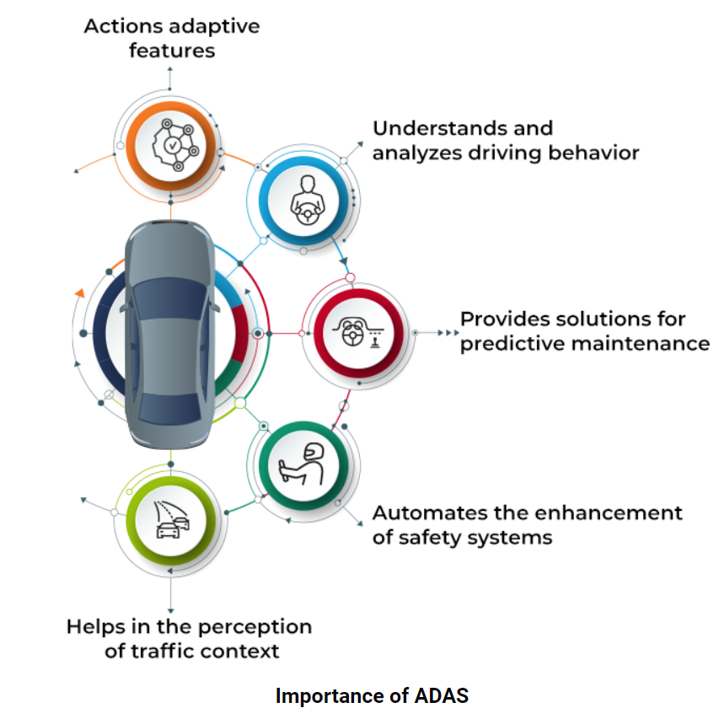
Abstract
This project aims at enhancing the vehicle automation through what is called “Advanced Driver Assistance Systems (ADAS)”. One of the ADAS is the Self-Parking System, which has been selected for development in this project.

Slide 5
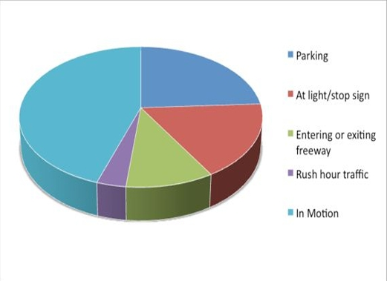
Why Self-parking ?
Parking is a necessary maneuver that occurs repeatedly as a result of daily use of the vehicle,
It is a challenge for inexperienced drivers.
It has the highest rate of vehicle collisions.
Self-parking aim at:
Improve parking efficiency.
Reduce driver fatigue.
Reduce the risk of accidents.

Slide 6
This project focuses on the development of one task of the full autonomous car driving system, which is Self-Parking.
The goal of car Self-Parking is to efficiently achieve car parking, perpendicular/parallel to the pavement, within the smallest available parking area and without the risk of collision.
This project employes many Mechatronics skills in the following areas:
Mechanical design of the vehicle platform.
Understanding & employing motion kinematics of the parking trajectories under collision-free constraint.
The proper selection & interface of sensors, actuators, microcontroller, and power supply to work efficiently as one integrated system in real time.
Modeling & Simulation of the parking maneuver trajectory on MATLAB to test & debug the model before hardware realization.

Slide 7

INTRODUCTION
An overview about the project.

Slide 8
1- Project Objectives
Goals
1
Performance
2
Cost
4
Reality
3

Slide 9
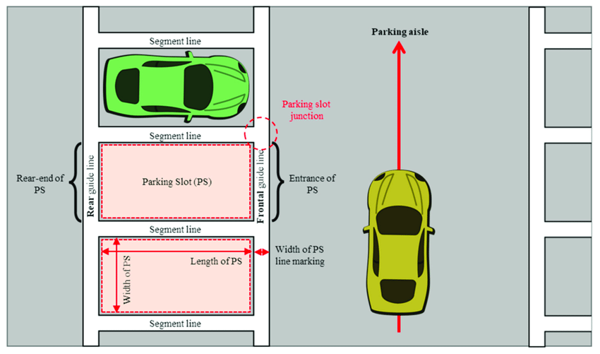
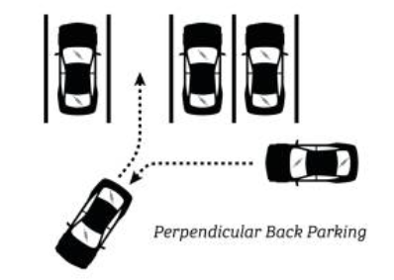
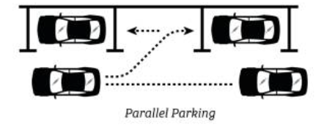
2- Brief Description of the Project

Slide 10
3- Project Main Parts:
Mechanical Design: Designing a model car with dimensions, propulsion and steering systems similar to real cars.
System Engineering: It concerns with the selection of sensors, actuators, microcomputer, and power supply, and the development of proper interfacing.
Path Planning: Modeling & Simulation of a collision-free parking maneuver trajectory.
On Board Control Software: Done by C & Embedded C programming language.

Slide 11
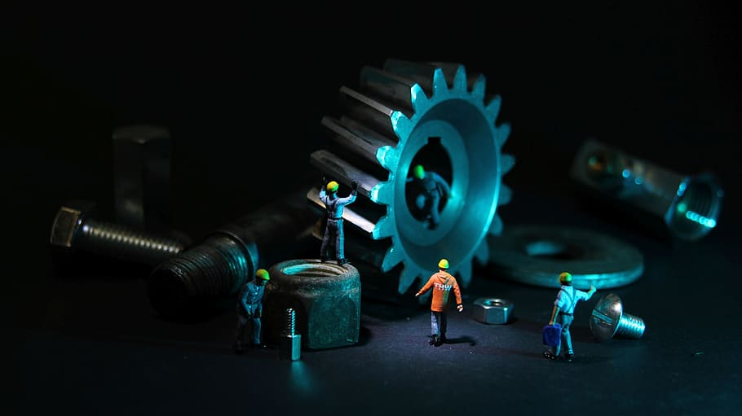
Mechanical Design
An overview of how the car was designed

Slide 12
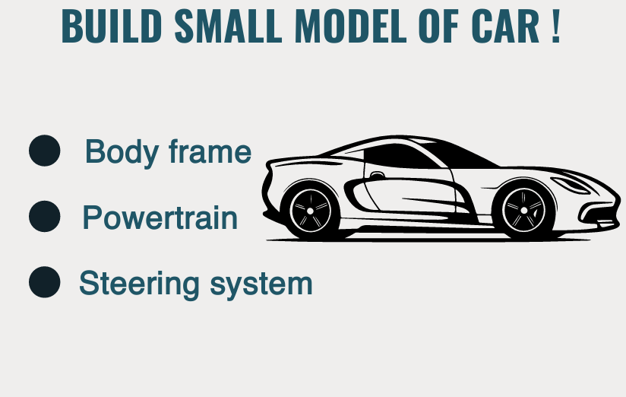

Slide 13
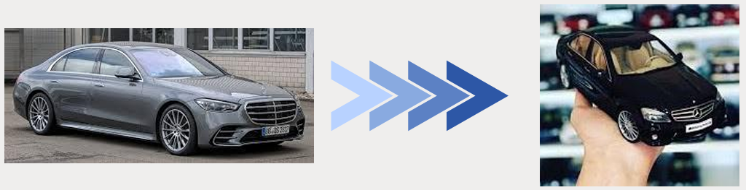
1- BODY FRAME DESIGN
The car platform is designed to be a scaled model for a real platform, i.e. a scale for the standard average dimensions for real cars, so that the developed algorithm for the parking maneuver would work for full scale models if divided by the scale factor.

Slide 14
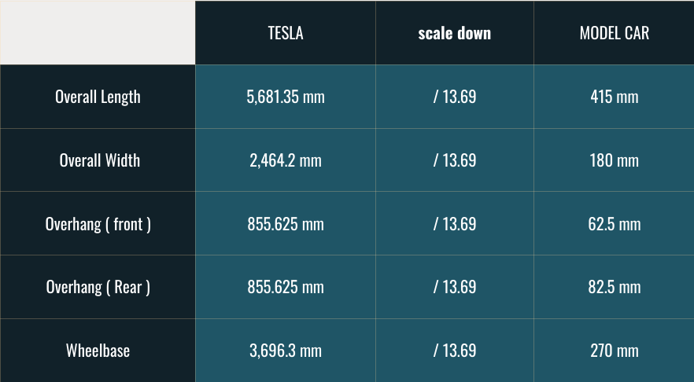
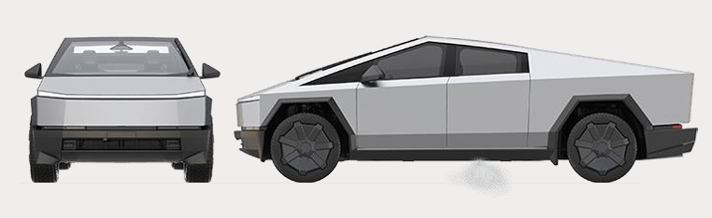
DIMENSIONAL CONVERSION
The Selected Car

Slide 15
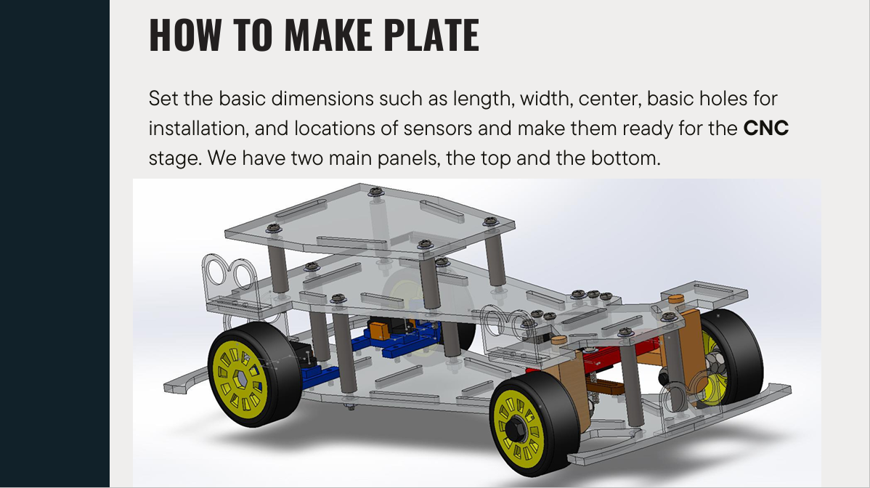
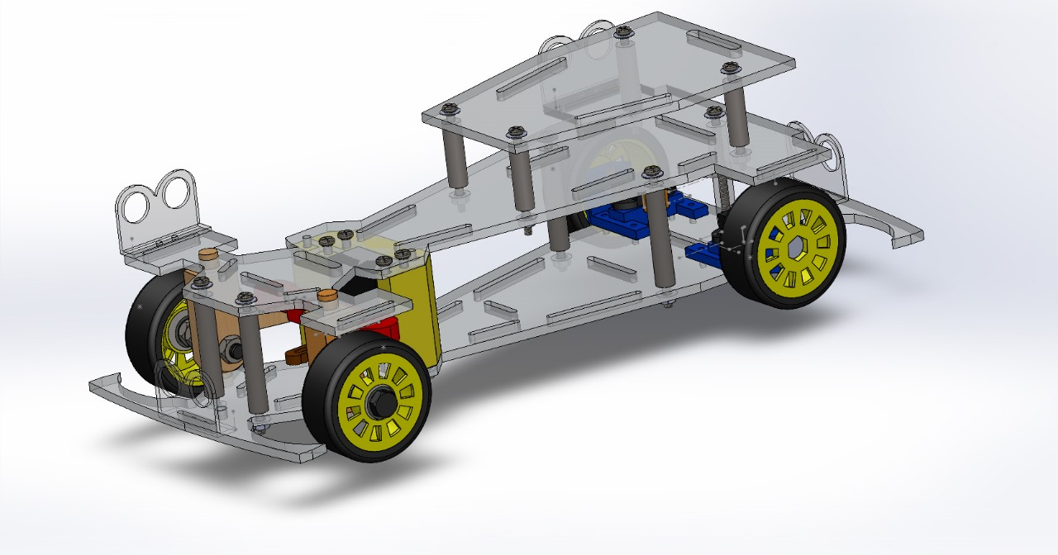

Slide 16
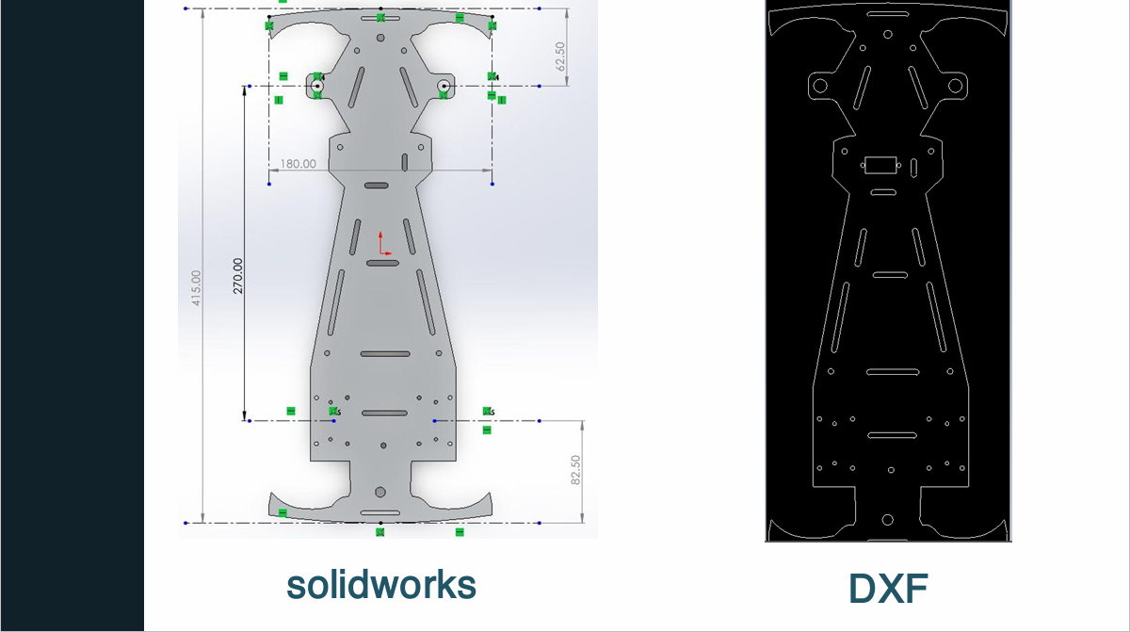

Slide 17
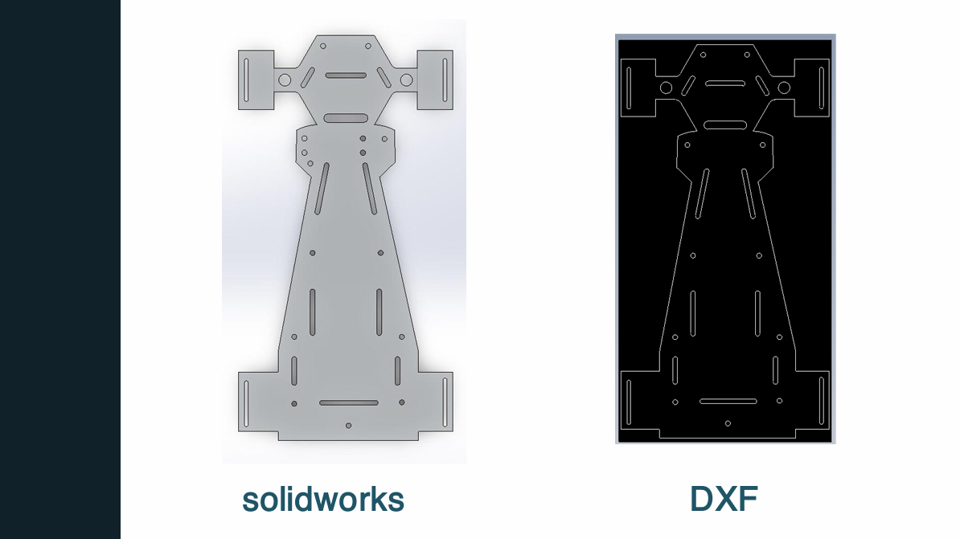

Slide 18
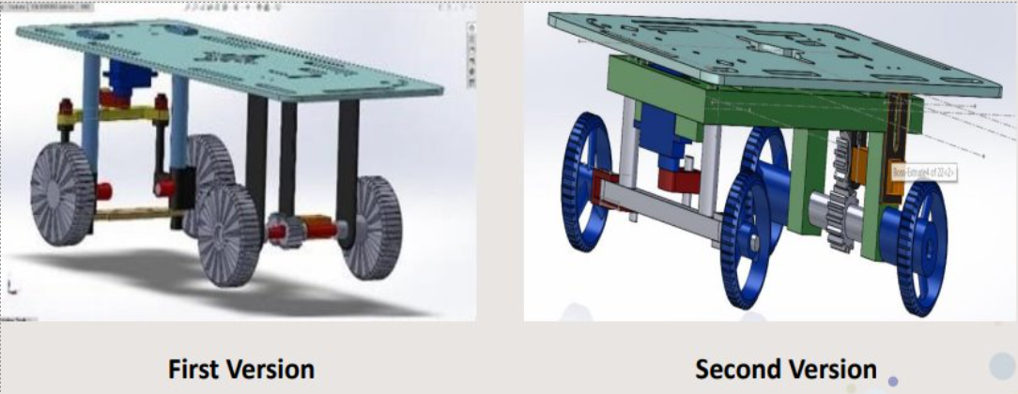
CAR OLD DESIGNS

Slide 19
2- POWERTRAIN DESIGN
Rear Wheel Drive, is a drivetrain layout in motor vehicles where the engine power is delivered to the rear wheels, propelling the car forward.
WHY WAS THIS CHOSEN ?
Simpler and more robust design
Requires less servicing
Easier to fix when repairs are needed

Slide 20
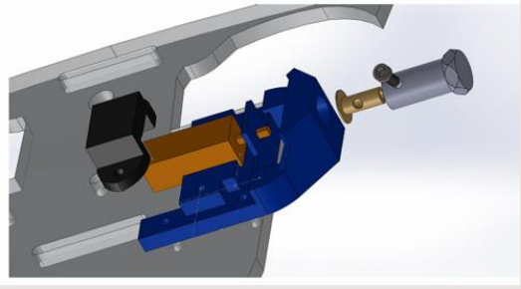
POWERTRAIN PARTS
Wheels
Coupling
Housing
Bolts & Nuts
Motor

Slide 21
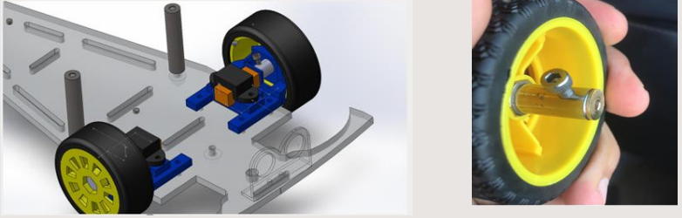
POWERTRAIN ASSEMBLY

Slide 22
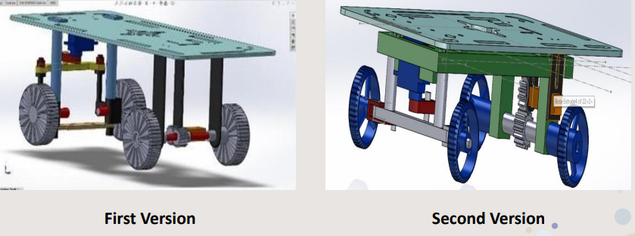
POWERTRAIN DESIGN VERSIONS

Slide 23
3- STEERING SYSTEM DESIGN
While the steering wheel appears simple, it uses scientific principles to achieve smooth handling. A key concept is Ackermann steering, which accounts for the different angles needed by the inner and outer wheels during turns. This principle ensures precise cornering and is a fundamental part of modern vehicle design. Over time, steering systems have evolved from mechanical to electronic and hydraulic, but the core principle of Ackermann steering remains essential for optimal car handling.

Slide 24
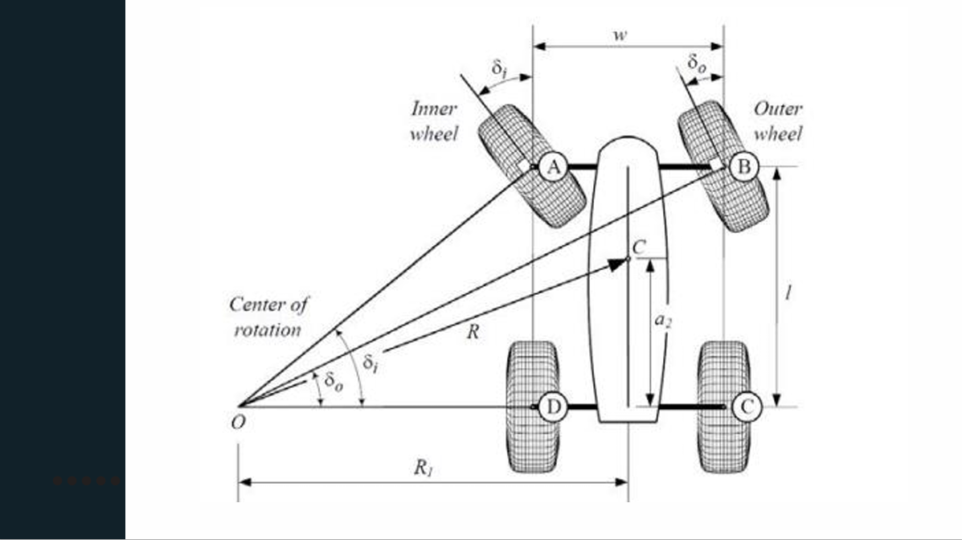

Slide 25
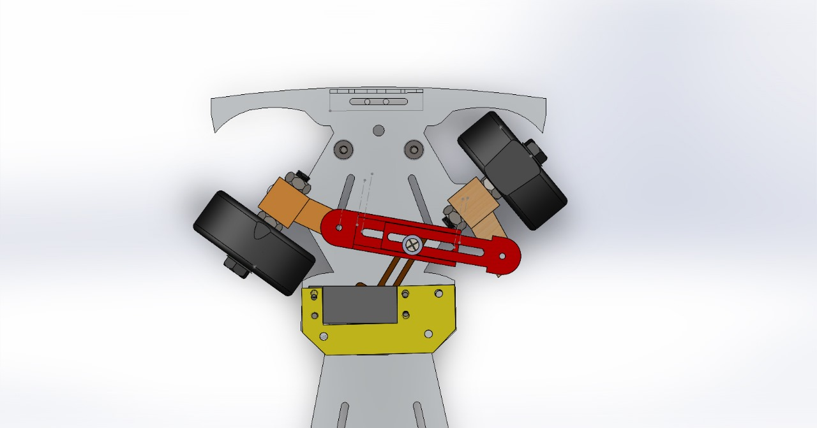

Slide 26
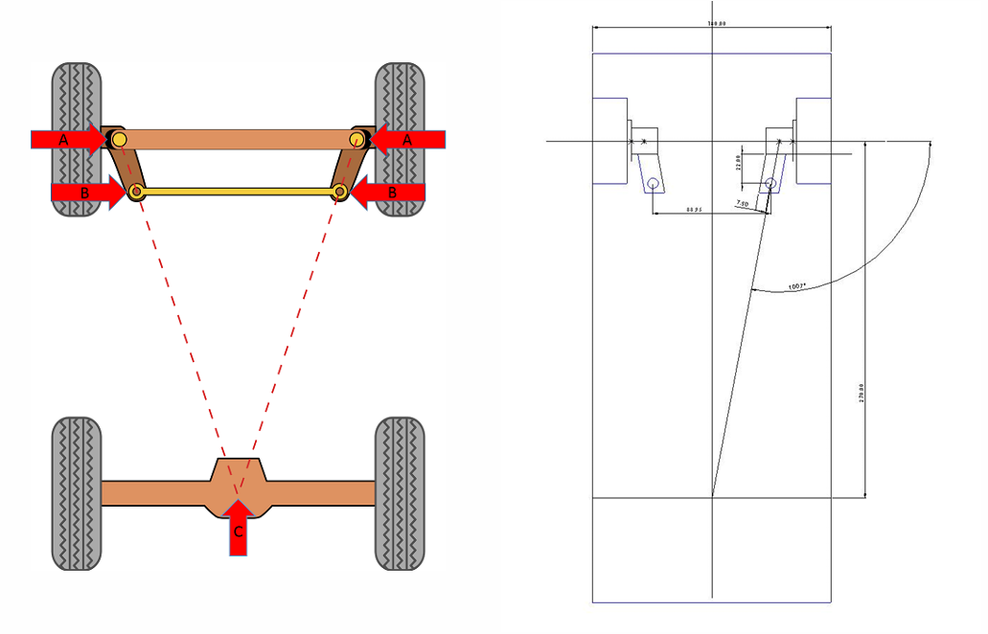
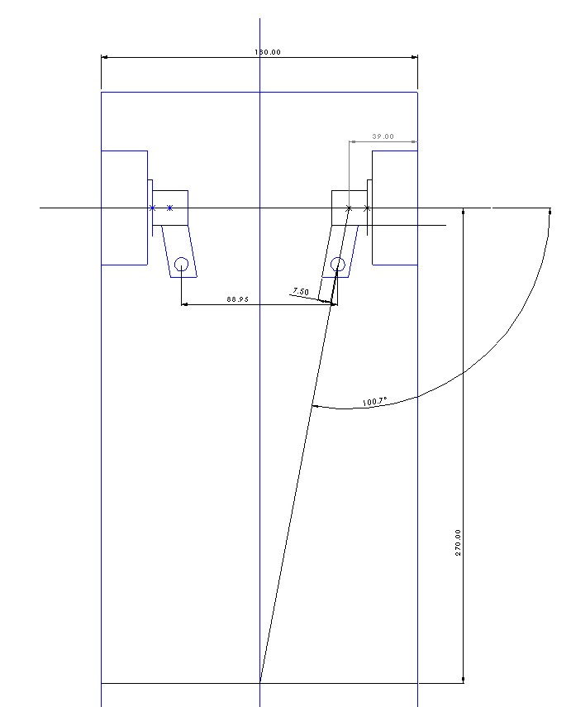
HOW TO MAKE IT ?

Slide 27
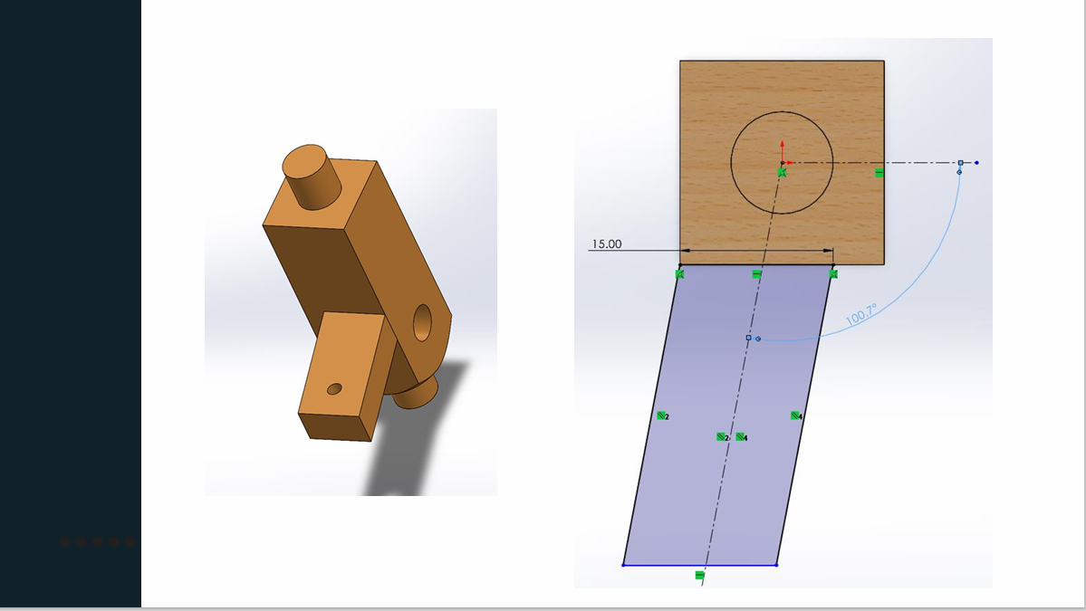

Slide 28
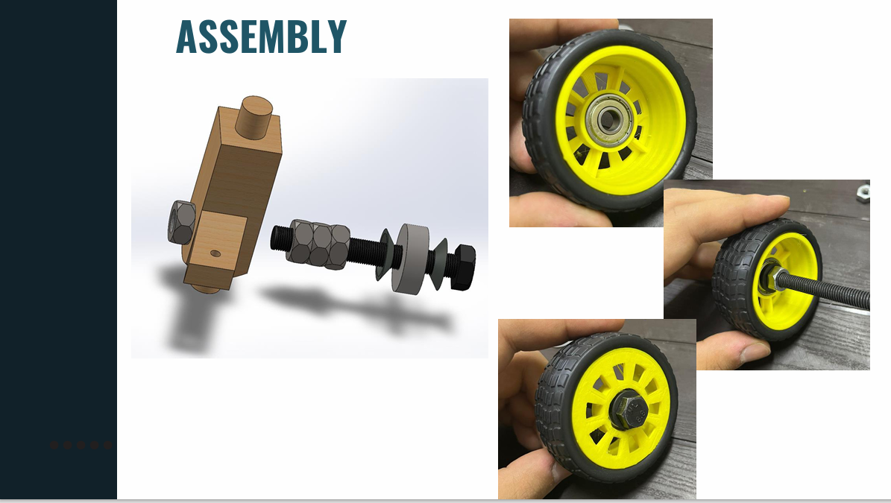

Slide 29
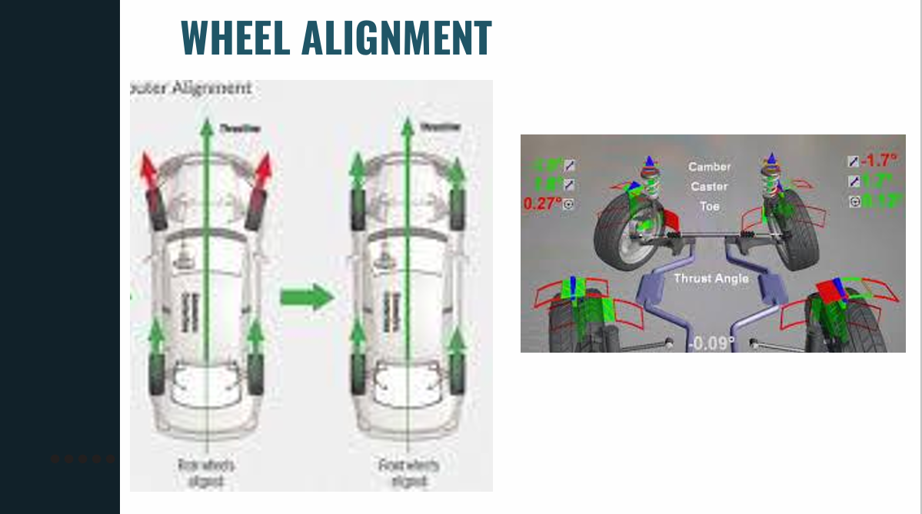

Slide 30
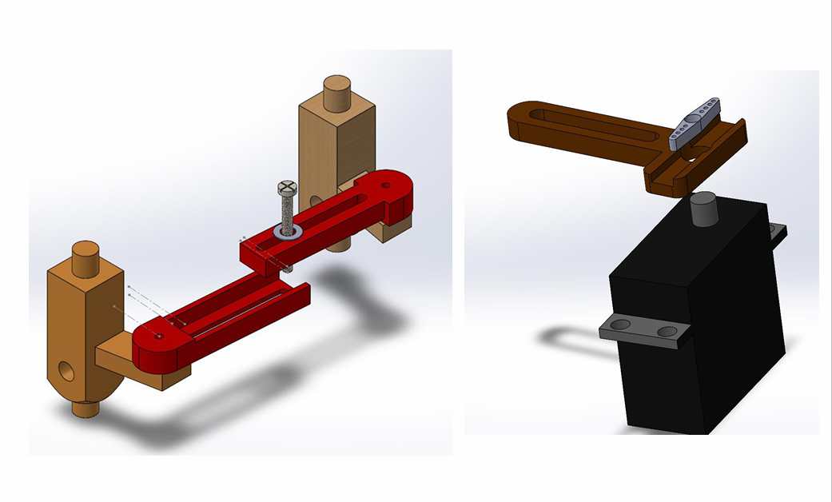
HOW TO FIX IT ?

Slide 31

Mechatronics System
In this part, the components and circuit design will be presented

Slide 32
1- Components
Blue Pill - STM32F103C8 Microcontroller
ULTRASONIC SENSOR
SERVO MOTOR
DC Geared Motor
L298N Dual H-Bridge Motor Driver
Power Supply
Battery Holder (3 x 18650)
Battery Management System (BMS 3S 10A 12V)
LM2596HVS-ADJ DC-DC Step-Down Module (3A)
Boat Rocker Switch ON-OFF

Slide 33
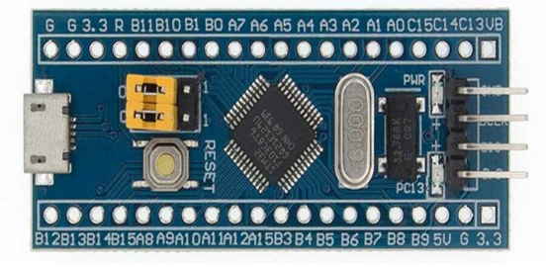
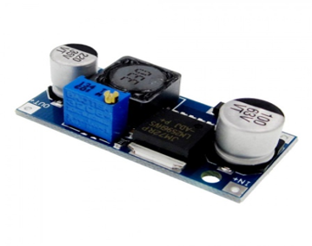
1) Blue Pill STM32F103c8 Microcontroller:
ARM Cortex-M3 Core, operates at a max frequency of 72 MHz
Memory, 64 KB of Flash memory & up to 20 KB of SRAM.
Peripherals such as timers, UARTs, SPI, I2C interfaces, ADCs, DACs, and more.
The microcontroller offers several GPIO pins.
Why MCU based on ARM?
2) DC-DC Step Down Module:
3.3V, 5V, 12V, and adjustable output versions
Adjustable version output voltage range, 1.2V to 37V
Guaranteed 3A output load current
Input voltage range up to 40V
Thermal shutdown and current limit protection

Slide 34
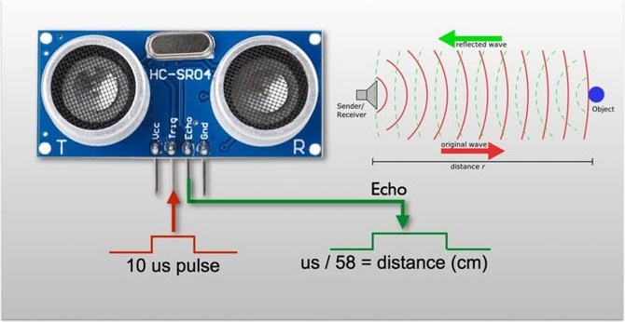
3) Ultrasonic Sensor:
Operating voltage: +5V
Theoretical Measuring Distance: 2cm to 400cm
Accuracy: 3mm (about 0.12 in)
Operating Current: <15mA
Operating Frequency: 40Hz
Why Ultrasonic Sensor over Infrared
Sensor (IR) ?

Slide 35
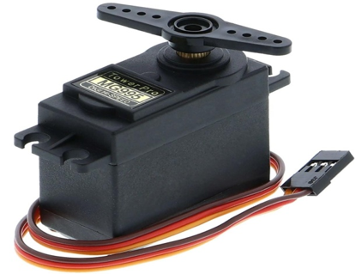
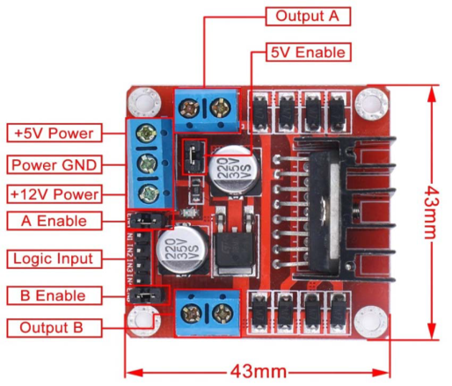
3) Servo Motor:
Dimension: 40.7 x 19.7 x 42.9 mm approx.
Stall torque: 8.5 kgf·cm (4.8 V ), 10 kgf·cm (6 V)
Operating voltage: 4.8 V to 7.2 V
Metal Gears
4) L298N Motor Driver:
Input Voltage: 3.2V~40Vdc.
Power Supply: DC 5 V - 35 V
Peak current: 2 Amp
Operating current range: 0 ~ 36mA

Slide 36
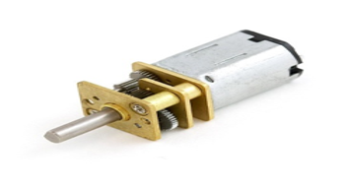
5) DC Geared Motor:
Voltage: 6~12V DC
Speed: 30 RPM
45mA (Current of No Load) 8 KG.CM (Stalling Torque)
Stall Current: 0.67A.
Full metal gears are wear resistant.
Why DC motor has been
selected over stepper motor?

Slide 37
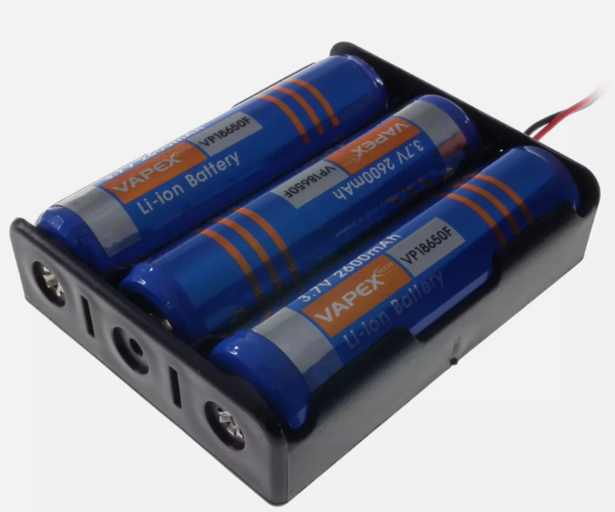
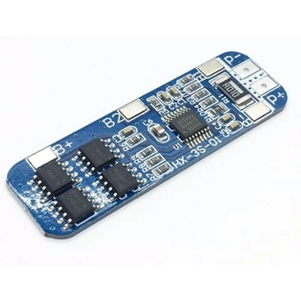
7) Lithium Batteries & Battery Holder:
Rechargeable lithium batteries with a voltage rating of 3.7V.
Batteries are in series, the total voltage output equals 3.7V * 3 = 11.1V.
8) Battery Management System (BMS):
Short circuit protection.
Overcharge protection.
Over-discharge protection.
Overcurrent protection.
Can be applied to various 3.7V lithium cores.

Slide 38
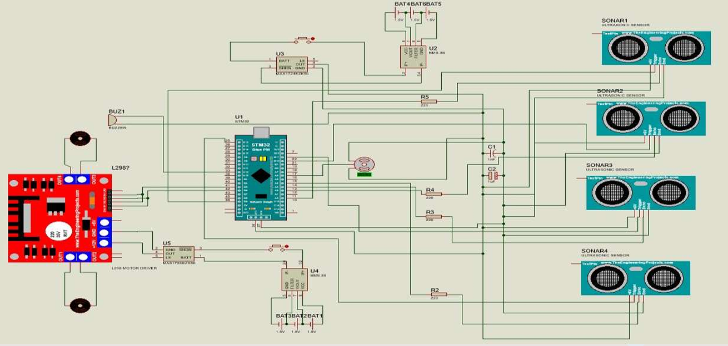
2 – Circuit Design & Electric Characteristic

Slide 39

Path Planning Algorithm
Path planning is the main key to the self-parking process. The stages of path planning will be presented

Slide 40
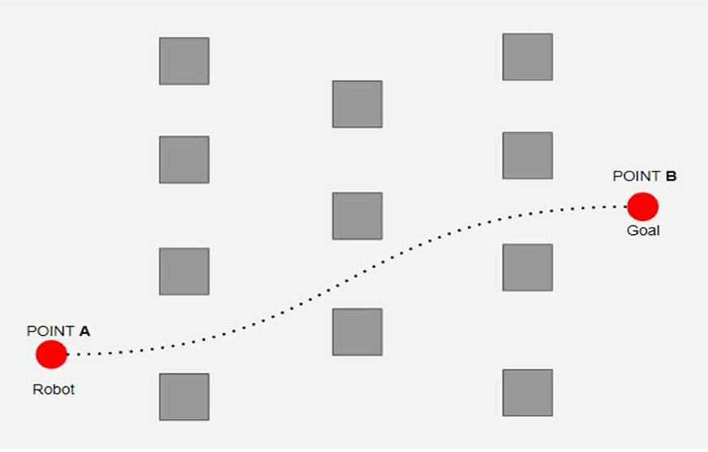
What is the meaning of a path planning?
Requires an appropriate addressing scheme that the robot can follow.
To solve the robot navigation problem, we need to find answers to the three following questions:
What is the proper starting point location?
What is the end point location?
What is the proper trajectory that connects the start & end points?
Answered by the three fundamental navigation functions , respectively:
Localization, mapping, and motion planning.

Slide 41
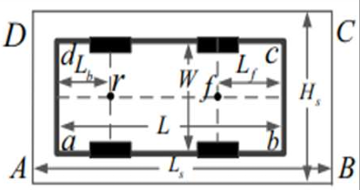
Vehicle Kinematics
Non-holonomic Systems,
Understanding the behavior of cars, especially during maneuvers like turning.
Its final position depends not only on the overall distance traveled but also on the specific path.
The low-speed method,
Avoid Sliding.
Increased response to changes in the surrounding environment.
Vehicle and Parking space
Considerations:​

Slide 42
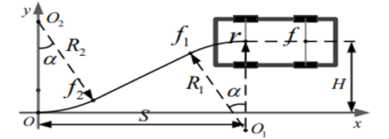
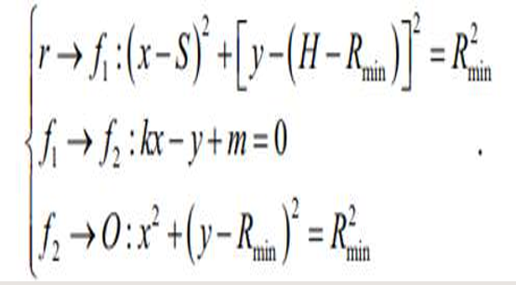
1- Parallel Parking Path Design
Path Type,
Circle – Straight Line – Circle (CSC)
Path Margins,
From start point (r) to f1
From f1 to f2
From f2 to end point (O)

Slide 43
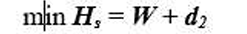
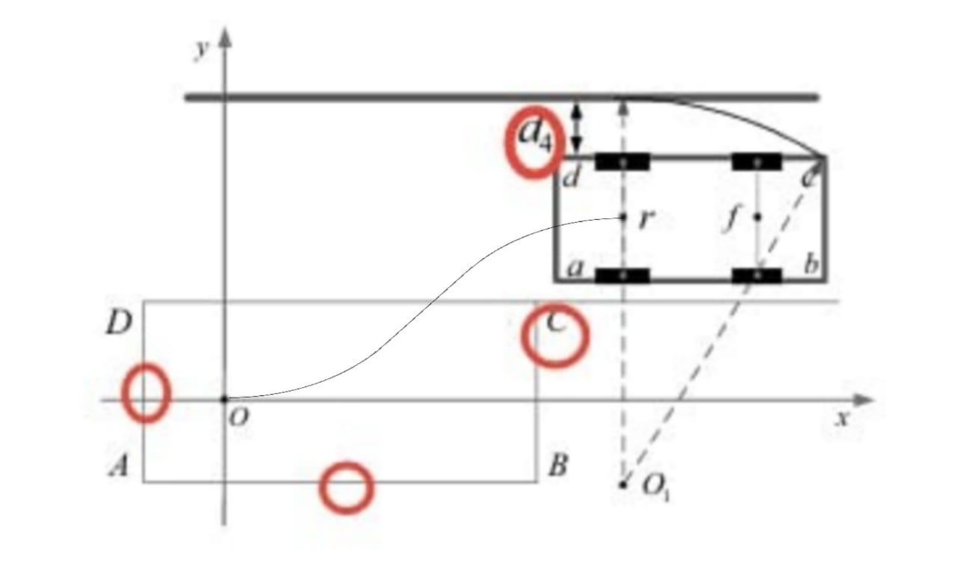
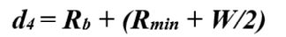
Collision-free Region, regions that collision may be occur:
Min Parking Space Length & width
1) Collision with AB (d2)
2) Collision between ab and CD (d3)
3) Track Width (d4)

Slide 44
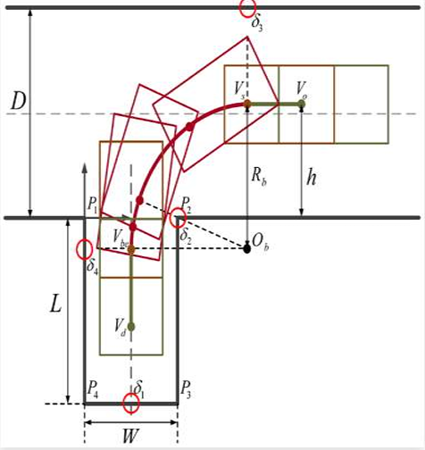
2- Perpendicular Parking Path Design
Path Type, ​
Circle – Straight Line (CS)​
Path Margins,​
From start point (Vs) to (Vbc) ​
From (Vbc) to (Vd)
​

Slide 45
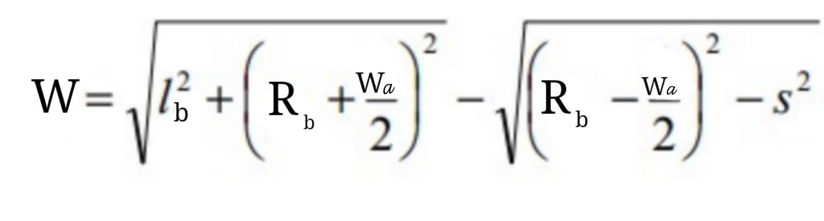
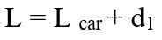
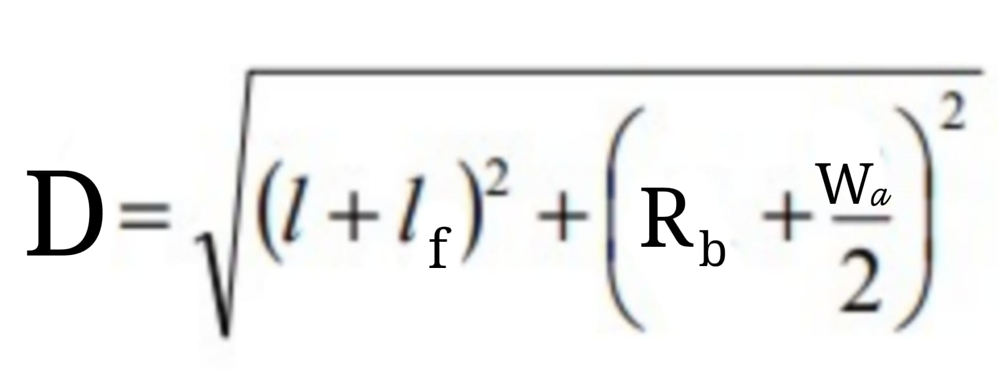
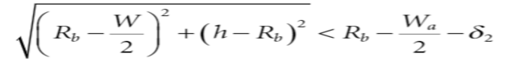
Collision-free Region, regions that collision may be occur:
Min Parking Space Length & width
1) Track Width
2) The collision of right side of rear axle with
P2 set as

Slide 46
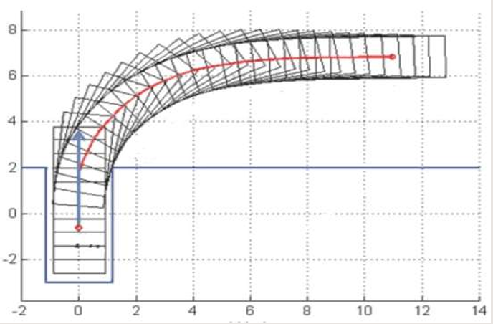
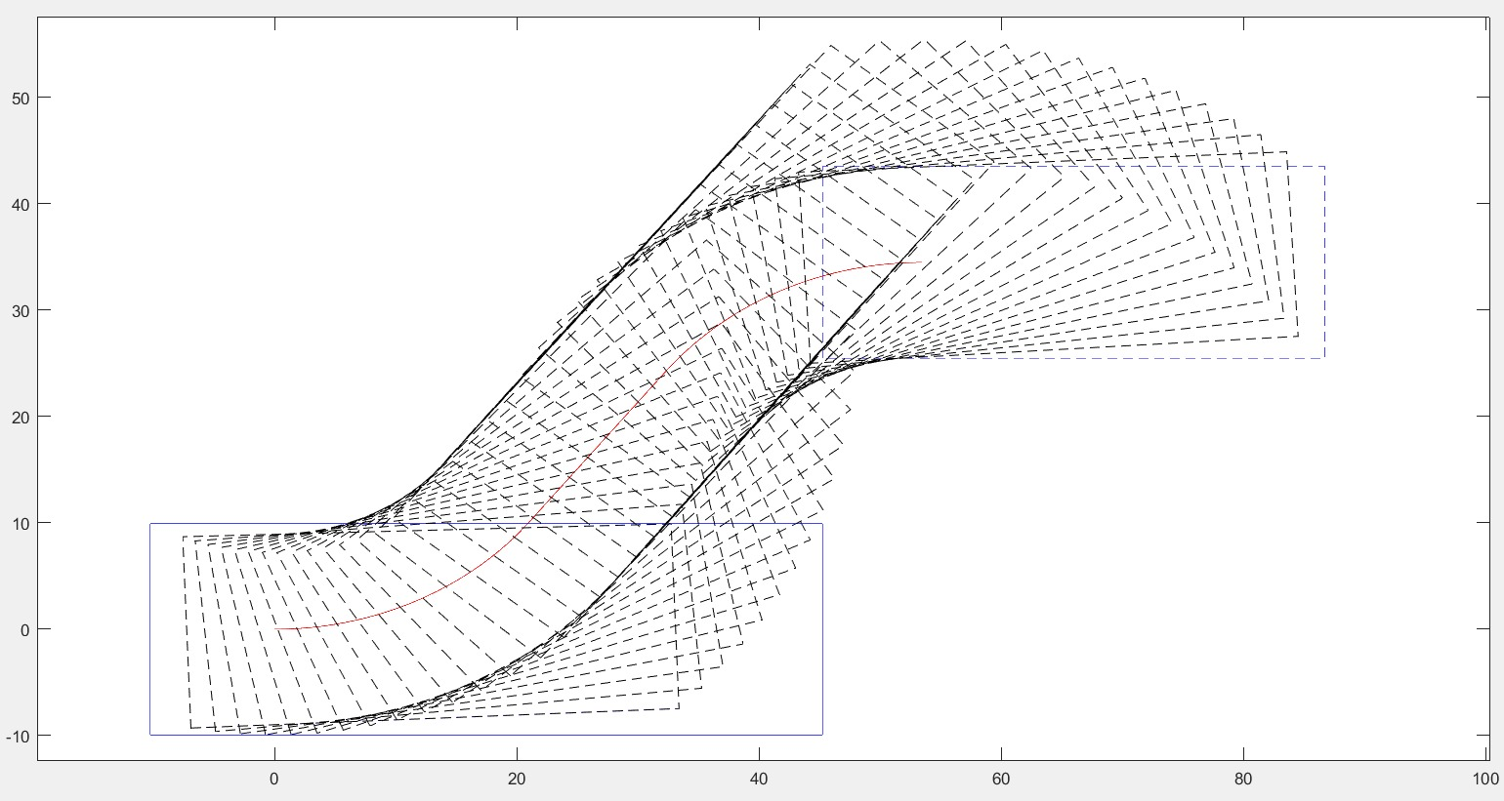
Path Planning Validation
The car trajectory has been modeled & programed utilizing MATLAB, as a soft test bench before hardware realization. This design phase is very important as an initial qualification of the path planning & an easy tool for path planning debugging.

Slide 48

Software
The coding stages will be presented and application algorithm

Slide 49
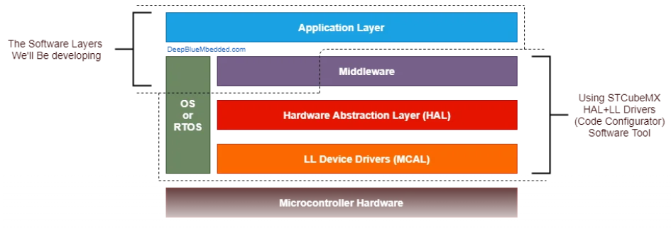
Needed Software Layers
MICROCONTROLLER ABSTRACTION LAYER (MCAL )
HARDWARE ABSTRACTION LAYER (HAL)
REAL TIME OPERATING SYSTEM (RTOS)
Application Layer

Slide 50

Software Development
The car software & algorithm has been programed and simulated using STM32CUBE IDE & Keiluvision5, as a soft test bench before hardware realization. ​
MCAL:
RCC GPIO
EXTI TIMERS
HAL:
DC MOTORS
SERVO MOTOR
ULTRASONIC SENSORS

Slide 51

RTOS
Multitasking
Task Scheduling
Resource Management
Real-Time Responsiveness

Slide 52
Application
Project Requirements:
Parallel & Perpendicular parking
Collision-free.
Dealing with any changes in the surrounding.
To reach the project requirements, sufficient data must be available about the environment surrounding the car, which is provided to us by the sensors.
Based on the sensor data, four states were created for the car to follow.
Suitable empty slot.​
Low time.

Slide 53
Mapping Algorithm
Mapping is a way to make the CU nearly see the surrounding environment the vehicle using sensor Fusion.
Why mapping is important for project?
To detect a suitable empty slot.
To decide suitable parking shape.
To deal with unexpected situations from its environment.
How to implement it?
Through the sensor data that is sent to the controller, it then processes it based on 4 cases and then makes a decision.

Slide 54

Application States:
State 1,
State 2,
If (US1 and US2 < w) state=1;​
If (US1 > w && state==1) state=2;
If (US1 > w && US2 > w) Calibrate on;
If (actual P length < min. P length) not parking, state==1;
If (actual parking length > min. parking length)
state3;

Slide 55
State 3,
State 4, path shape is formed.
If (US2 difference > w && state==3) state=4;
If (US2 > Parallel width and length) state4(Parallel_Parking);
If (US2 > perpendicular width and length)
state4 (perpendicular_Parking);

Slide 56
SW Verification & Validation
"Did i built it right?", which is the meaning of verification. It was done using Keiluvision5 and physical components on:
MCAL
HAL
RTOS
"Did i built the right thing?", which is the meaning of validation. It was done through real experimental using the car on:
Application

Slide 57

Conclusion and Future Work

Slide 58

Future Work
AI integration, AI and machine learning techniques can be used to analyze parking data and improve parking algorithms.
Image Identification, with the development of sensors used such as lidar to develop computer vision.
User interface development, application can be created on the phone that displays operations.

Slide 59
Conclusion
The goals of graduation project in the field of Mechatronics Engineering were set by our Advisor, and successfully accomplished by our team under his supervision. These goals could be summarized as follows:
Mechanical design, that uses dimensions appropriate to reality.
Mechatronics System, that comprises the interface & integration sensor, controller, the autonomous control coding, and actuators to form an autonomous mechatronics system.
Path planning that models the path the car should take to avoid a collision.
Software, embedded on the microcontroller to process the sensors data and provides the desired output commands for the motor and steering system.

Slide 60

Thank you

